Slide 1
WP Scan
a black box WordPress vulnerability scanner that can be used to scan remote WordPress installations to find security issues.

Slide 2
WPScan Wordpress security scanner
WPSCAN is a security scanner that attempts to find known security weaknesses within WordPress installations. The application is provided for free on the wpscan.org site.
The main features of WPScan include:
Username enumeration (from the author)
Multi-threaded, weak password cracking
Version enumeration, vulnerability enumeration, plugin enumeration
WordPress is the world’s most popular tool for creating websites. WordPress is capable of creating any style of website. 32.7% of all websites are built with WordPress.

Slide 3
What is WordPress?
WordPress is software you can use to create your own website, blog, or even an application. Since it was first released in 2003, WordPress has matured into a highly flexible “content management system,” or CMS. And today, it powers more than 32.7% of the entire web—including some of the most popular websites you’ve probably heard of.
WordPress enables you to build and manage your own full-featured website using just your web browser—without having to learn how to code. In fact, if you’ve ever used a text editor like Microsoft Word, you’ll be right at home with the WordPress Editor.

Slide 4
WordPress Vulnerabilities That allow hackers to obtain access to a site
1. Authenticated File Delete
2. Authenticated Post Type Bypass
3. PHP Object Injection via Meta Data
4. Authenticated Cross-Site Scripting (XSS)
5. Cross-Site Scripting (XSS) that could affect plugins
6. User Activation Screen Search Engine Indexing
Exposes emails and default generated passwords to search engines
7. File Upload to XSS on Apache Web Servers

Slide 5
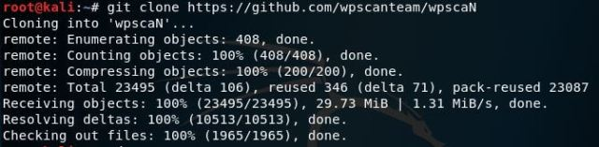
How to get WPScan…
Install can be done through github
git clone https://github.com/wpscanteam/wpscanN
Go to the directory where you have downloaded wpscan and install the bundle file.
bundle install && rake install

Slide 6

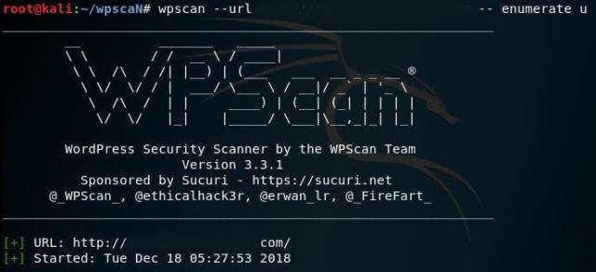
Continued…
Now to use WPScan
Use the command line
wpscan --url http://yourTarget.com --enumerate u
u= User information
p= Plugins
t= Themes
This basic command will scan your website and identify the active themes and other exposed vulnerable information

Slide 7
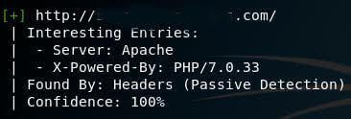
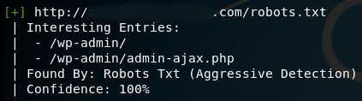
Continued…
Exposed webserver type of the website
The Administrative Login page of the Wordpress Site

Slide 8
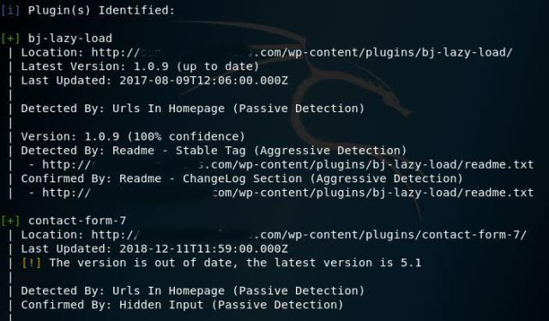

Continued…
The exposed Wordpress version
Vulnerable Plugins

Slide 9
Side Note
Vulnerable Plugins in the website will be fetched, depicting its various categories right from the most vulnerable ones [with a red exclamation mark] up to the plugins which aren’t updated. Meaning, each and every vulnerable information will be represented.

Slide 10
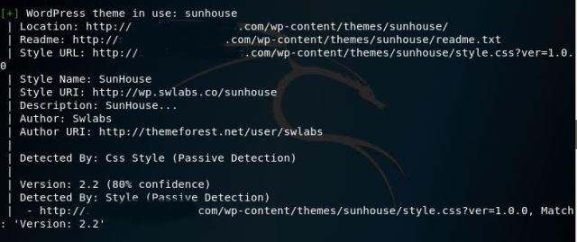
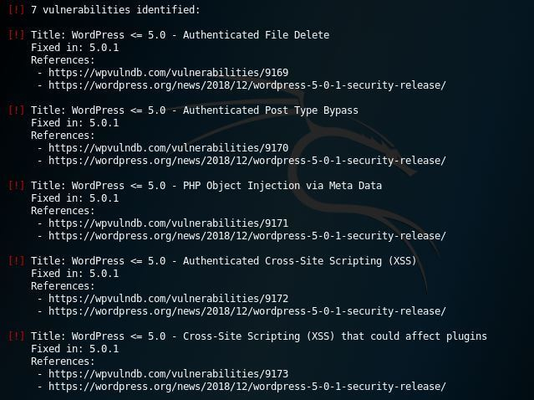
Continued…
Vulnerable themes
You can see the list of vulnerabilities identified specifically with respect to your website:

Slide 11
Now you Know
You can now scan your website thoroughly to check for vulnerabilities and isolate them.
Always keep your WordPress site and plugins up to date.
Always have a strong password with capital letters, numbers, symbols, and spaces.

Slide 12
Sources
https://kalilinuxtutorials.com/wpscan-checks-vulnerabilities/
https://www.searchenginejournal.com/7-wordpress-vulnerabilities/283107/
https://www.wp101.com/tutorial/what-is-wordpress/
https://w3techs.com/technologies/details/cm-wordpress/all/all

